Slide 1
PRESENTATION ON UNITED NATIONS
NAME: S.M. TASNIMUL HASAN
ID: 18.02.04.142
SECTION: B
GROUP: B2

Slide 2
CONTENTS
History of The United Nations
Leaders
Objectives of The United Nations
Five Permanent Members of United Nations
Six Principal Organs of United Nations
Official Languages of United Nations
Secretary-Generals of the United Nations
UN Successes

Slide 3

Flag of the United Nations

Slide 4
History of the United Nations
Founded: October 24, 1945, San Francisco, California, United States
Headquarters: New York City, New York, United States
Members when founded: 51 Member States
Members now: 193 Member States & 2 Observer States

Slide 5
Leaders
Secretary-General : Antonio Guterres
Deputy Secretary-General : Amina Jane Mohammed
General Assembly President : Maria Fernanda Espinosa
Economic and Social Council President : Inga Rhonda King
Security Council President : Francois Delattre

Slide 6
Objectives of the United Nations
To maintain international peace and security
To develop friendly relationships among nations
To cooperate in solving international problems
To promote human rights
To be a centre for helping nations
To respect the principle of equal rights

Slide 7





Five Permanent Members of UN

Slide 8
Six Principal Organs of UN
General Assembly
Security Council
Economic and Social Council
Trusteeship Council
International Court of Justice
UN Secretariat

Slide 9
Official Languages of UN
Arabic
Chinese
English
French
Russian
Spanish

Slide 10
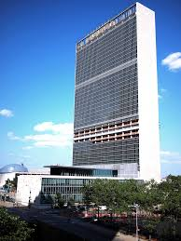
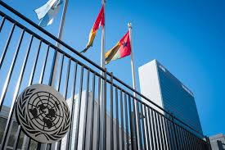
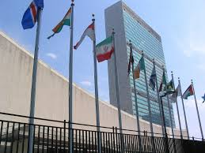
UN Secretariat

Slide 11
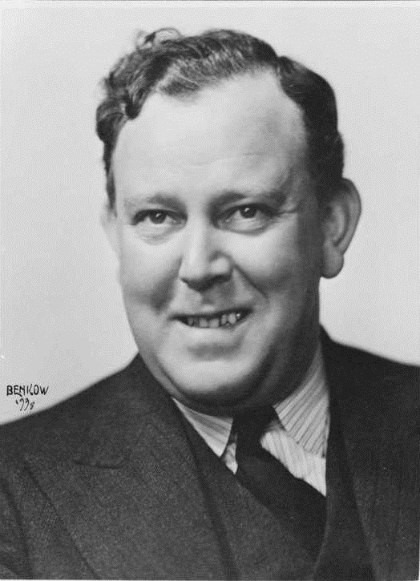
Does anybody know this person?

Slide 12

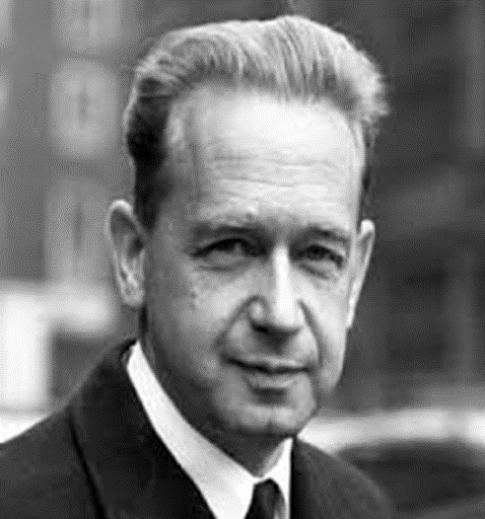
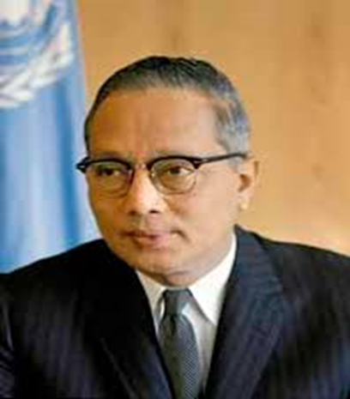
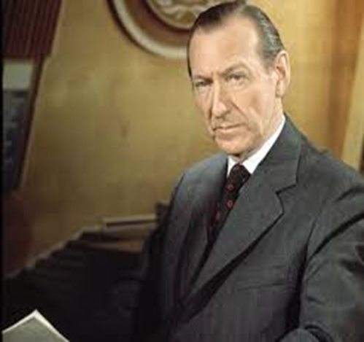
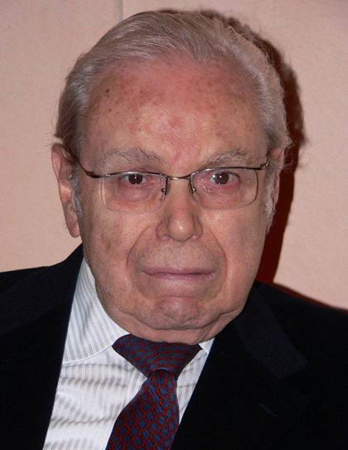
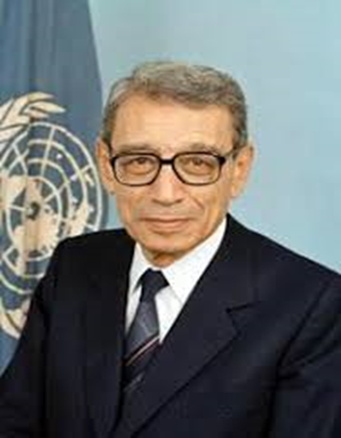
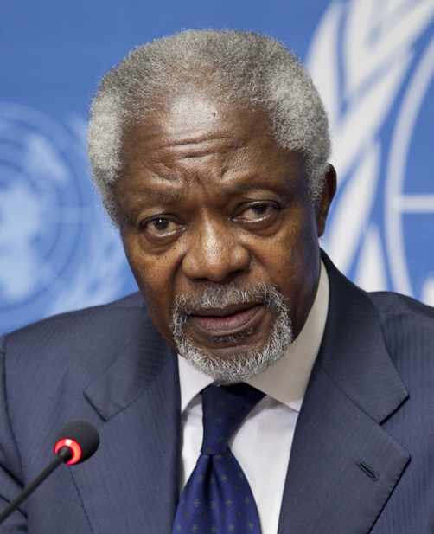
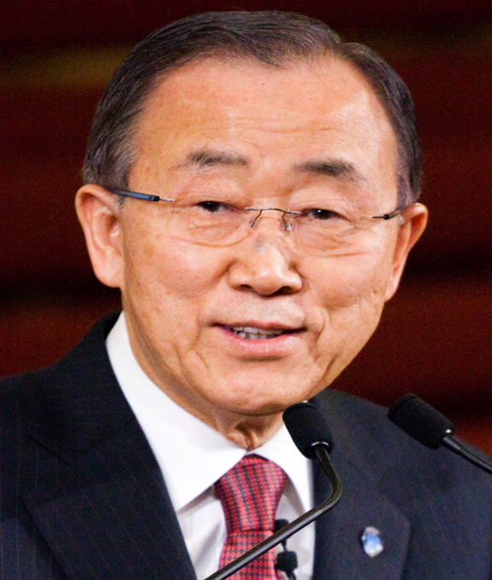
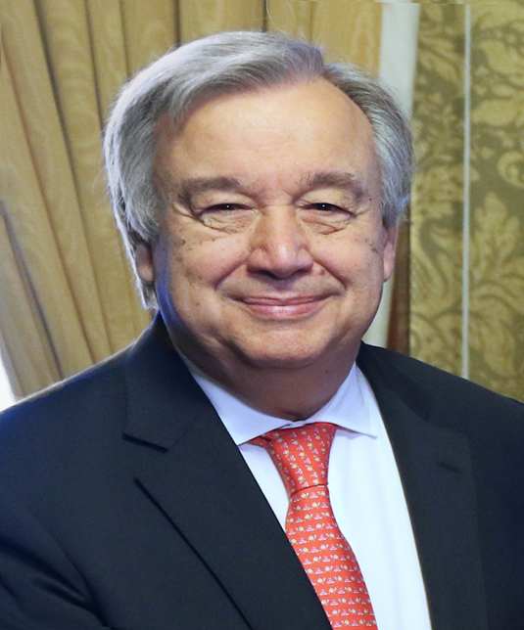
Secretary-Generals of the UN

Slide 13
UN Successes
Since its inception, the United Nations has performed numerous humanitarian, environmental and peace-keeping undertakings, including:
Providing food to 90 million people in over 75 countries
Assisting more than 34 million refugees
Authorizing 71 international peacekeeping missions
Working with 140 nations to minimize climate change
Protecting human rights with 80 treaties and declarations

Slide 14
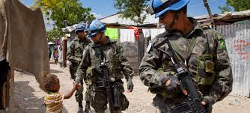
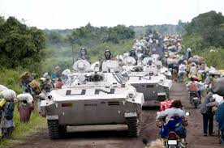
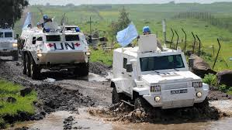
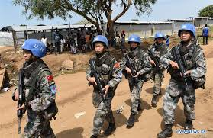
UN Peacekeeping Missions

Slide 15

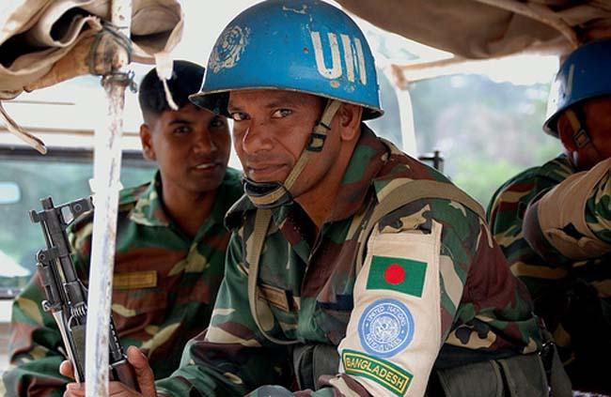
Bangladesh in UN Peacekeeping Missions

Slide 16
Source: Google, Wikipedia

Slide 17

Any Question ?

Slide 18
Thank You

